Slide 1
樂芙廚房 Lefu kitchen
by Michel Bru
International food for School Catering & Food Services
96%
2022-2023 SATISFACTION

Slide 2
OUR SERVICE
OUR FOOD
Menu released 1 month in advance
Nutritional information
Western & Asian food
School catering service
Healthy meals service
Customized food service catering
EVERYDAY
We send the menu of the day by email to parents, along of nutritional information.
We cook fresh
We deliver your place
QUALITY
Food is cooked on the day
Only fresh ingredients
Locally sourced where possible

Slide 3
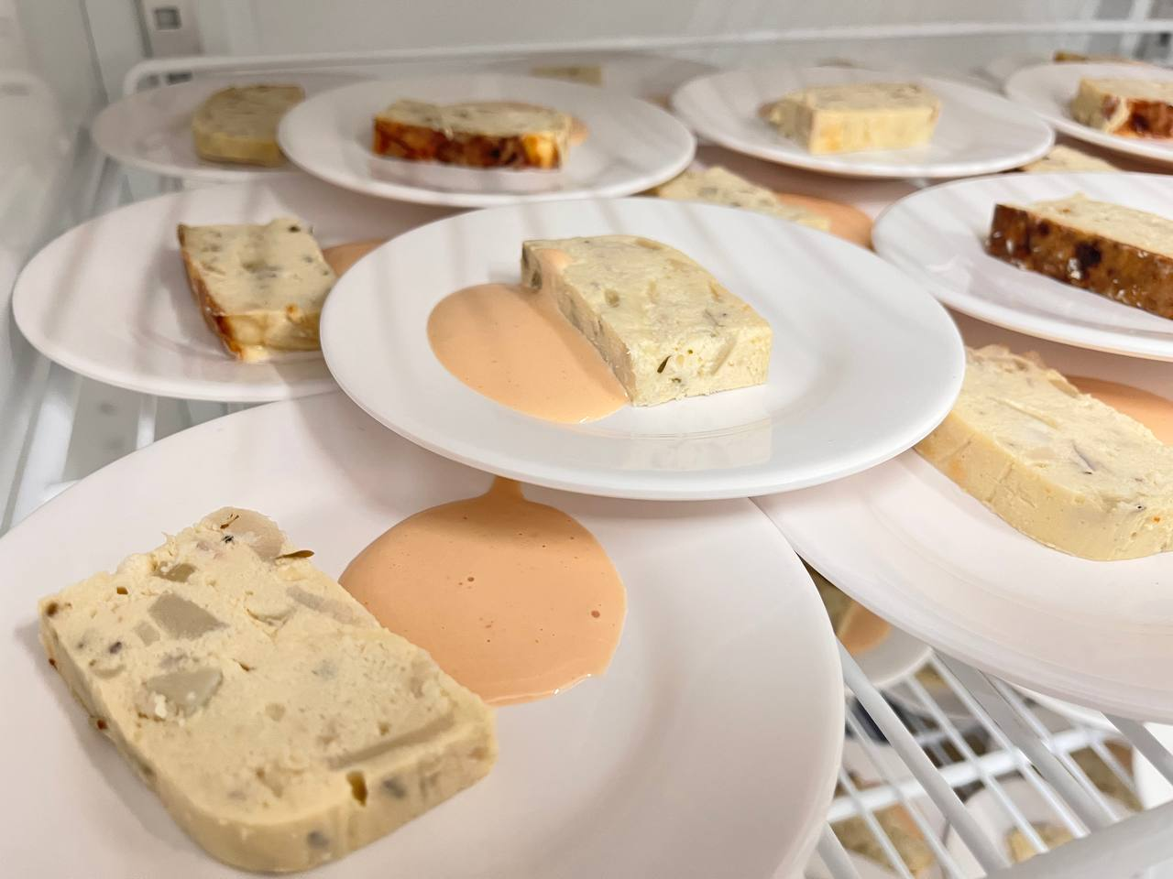
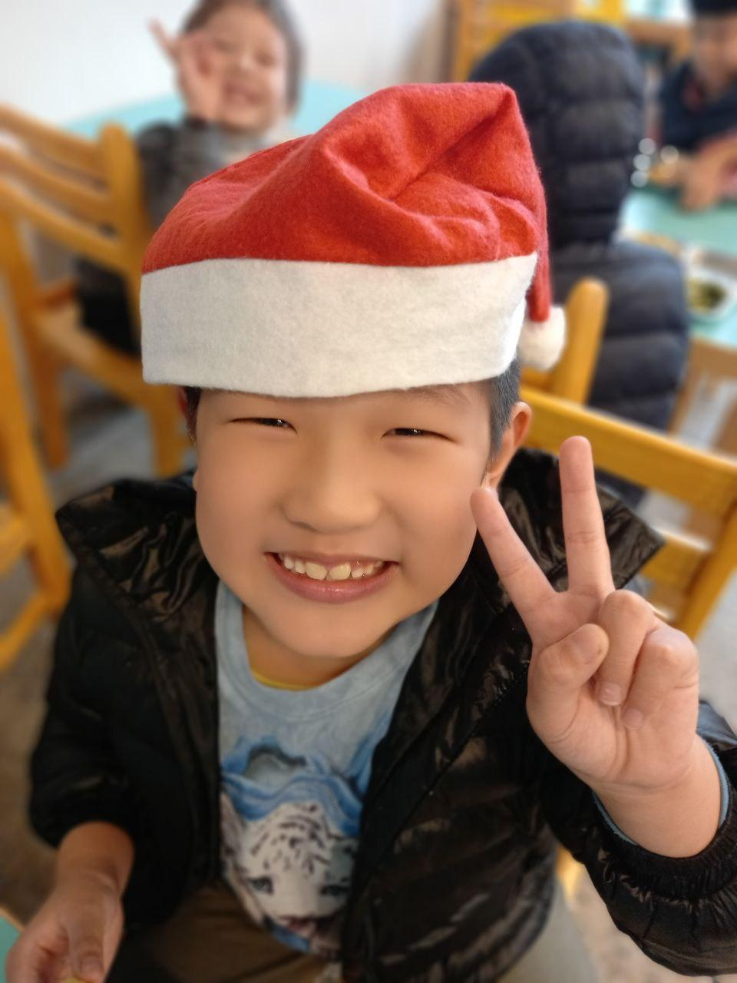
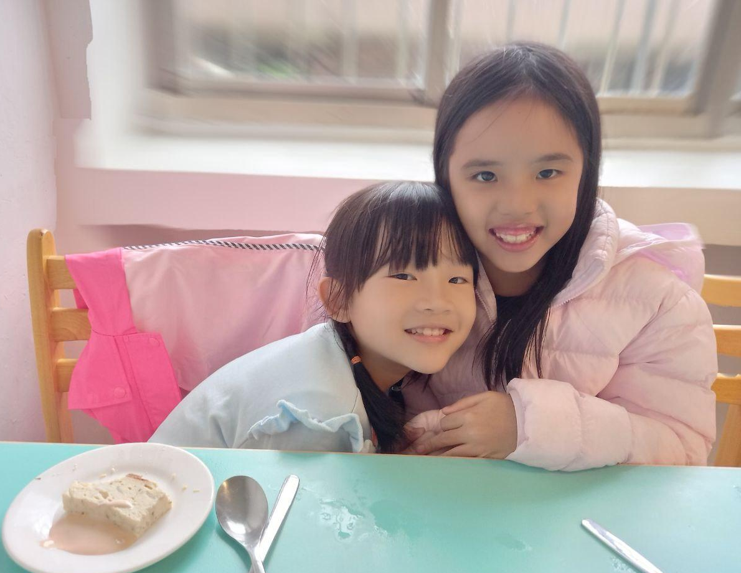
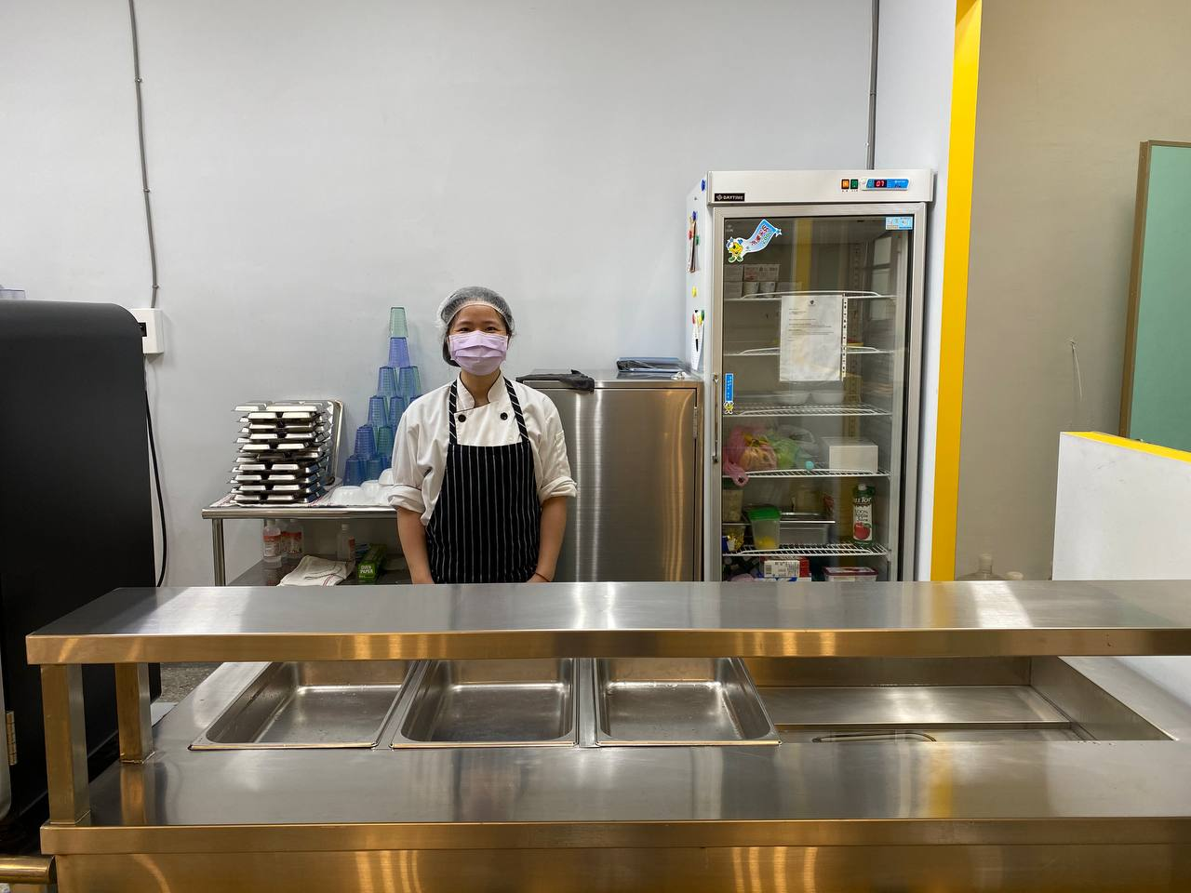

Slide 4
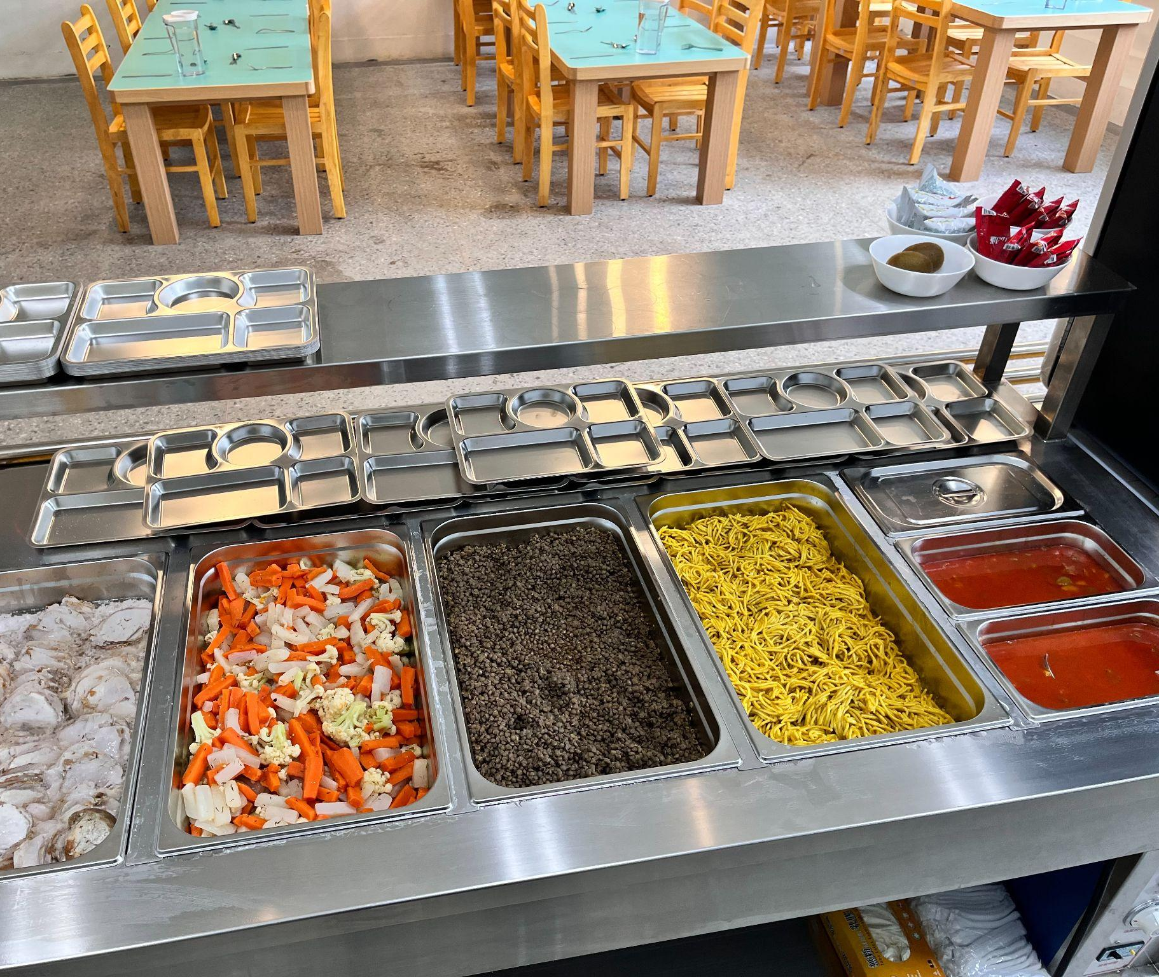
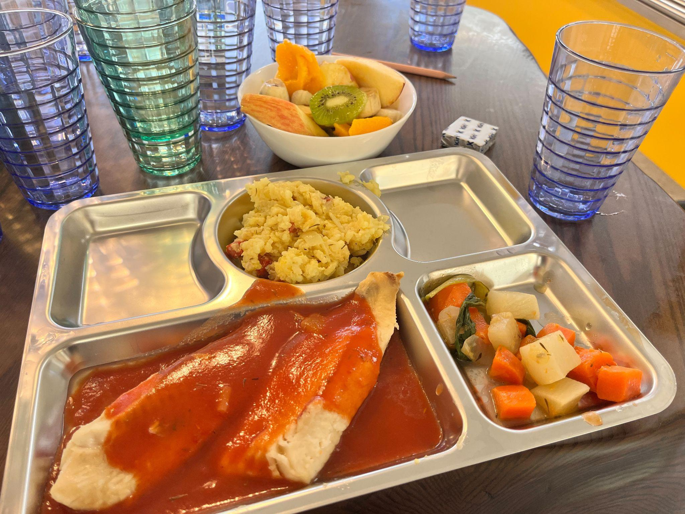
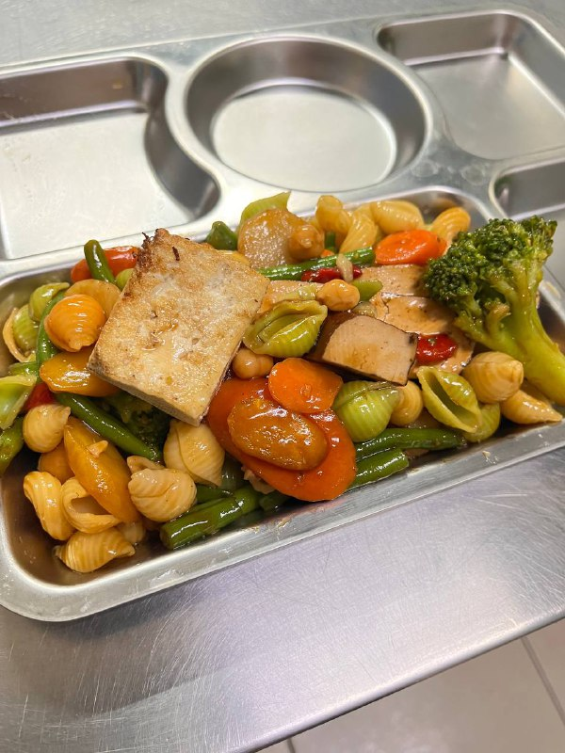
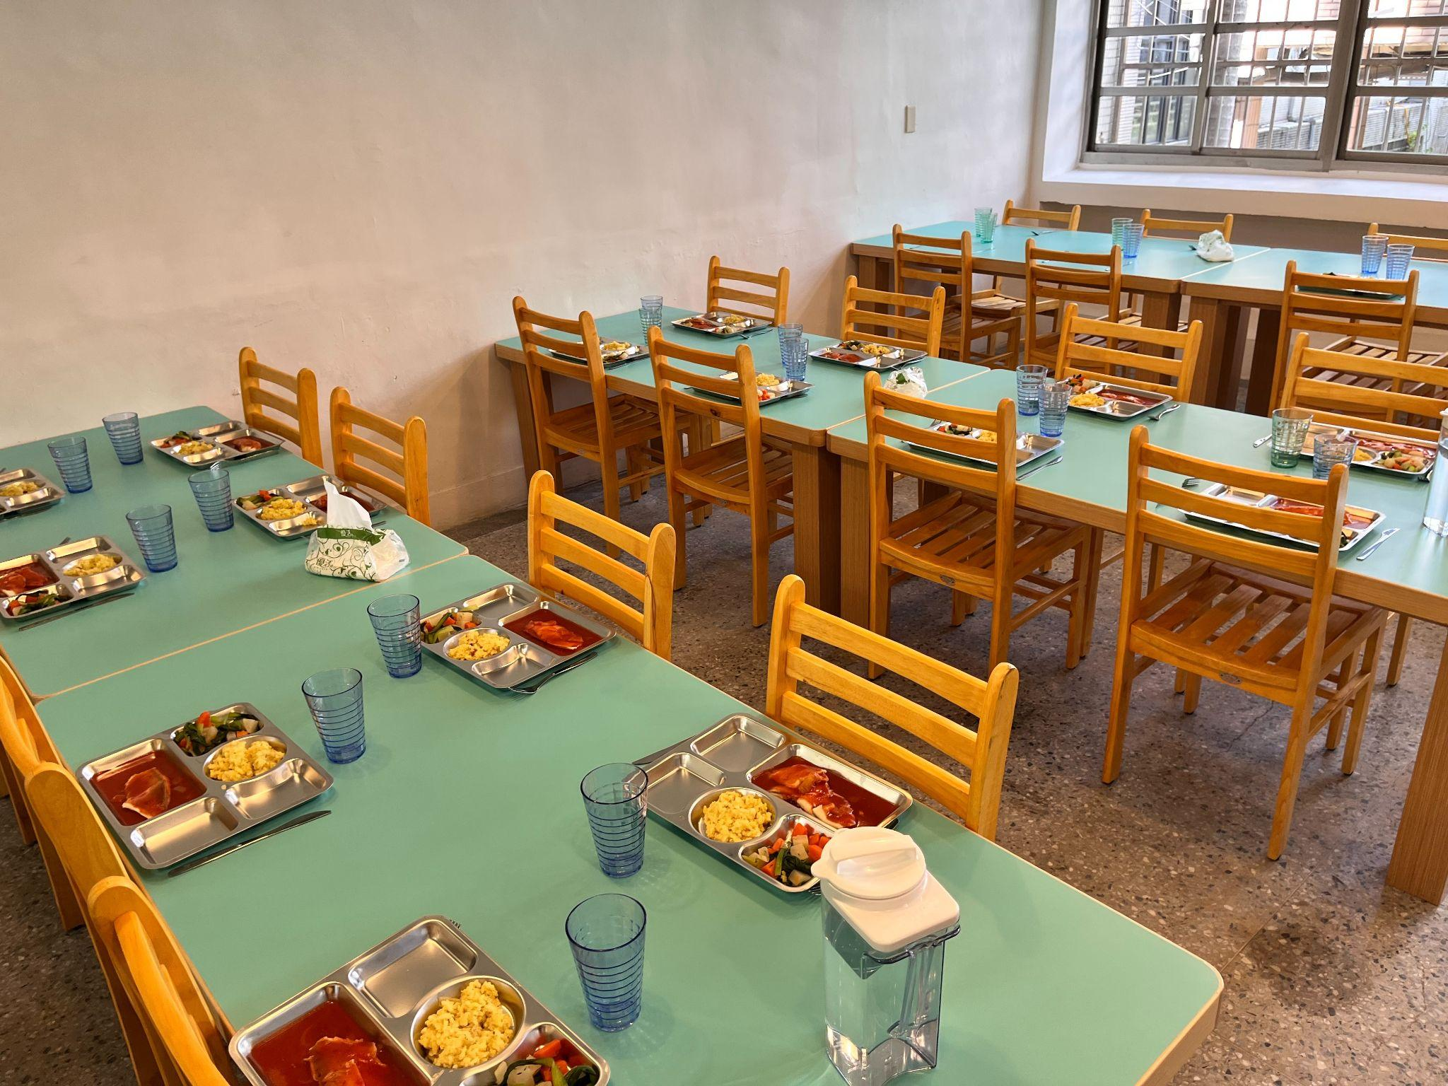
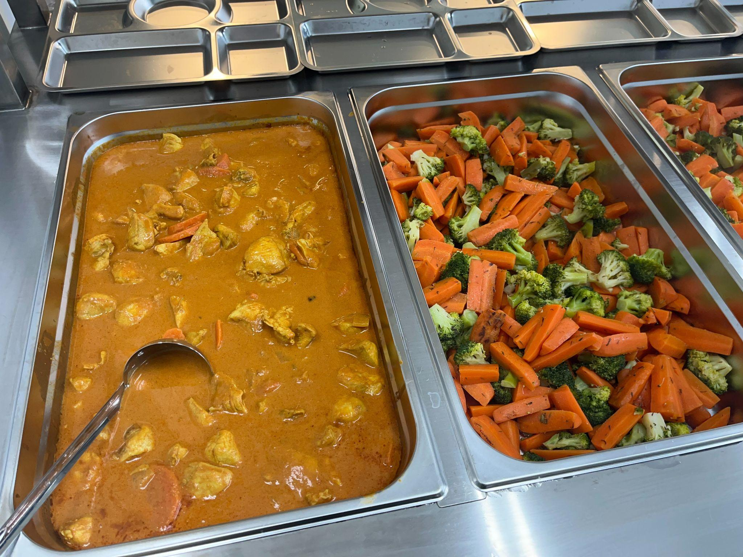

Slide 5
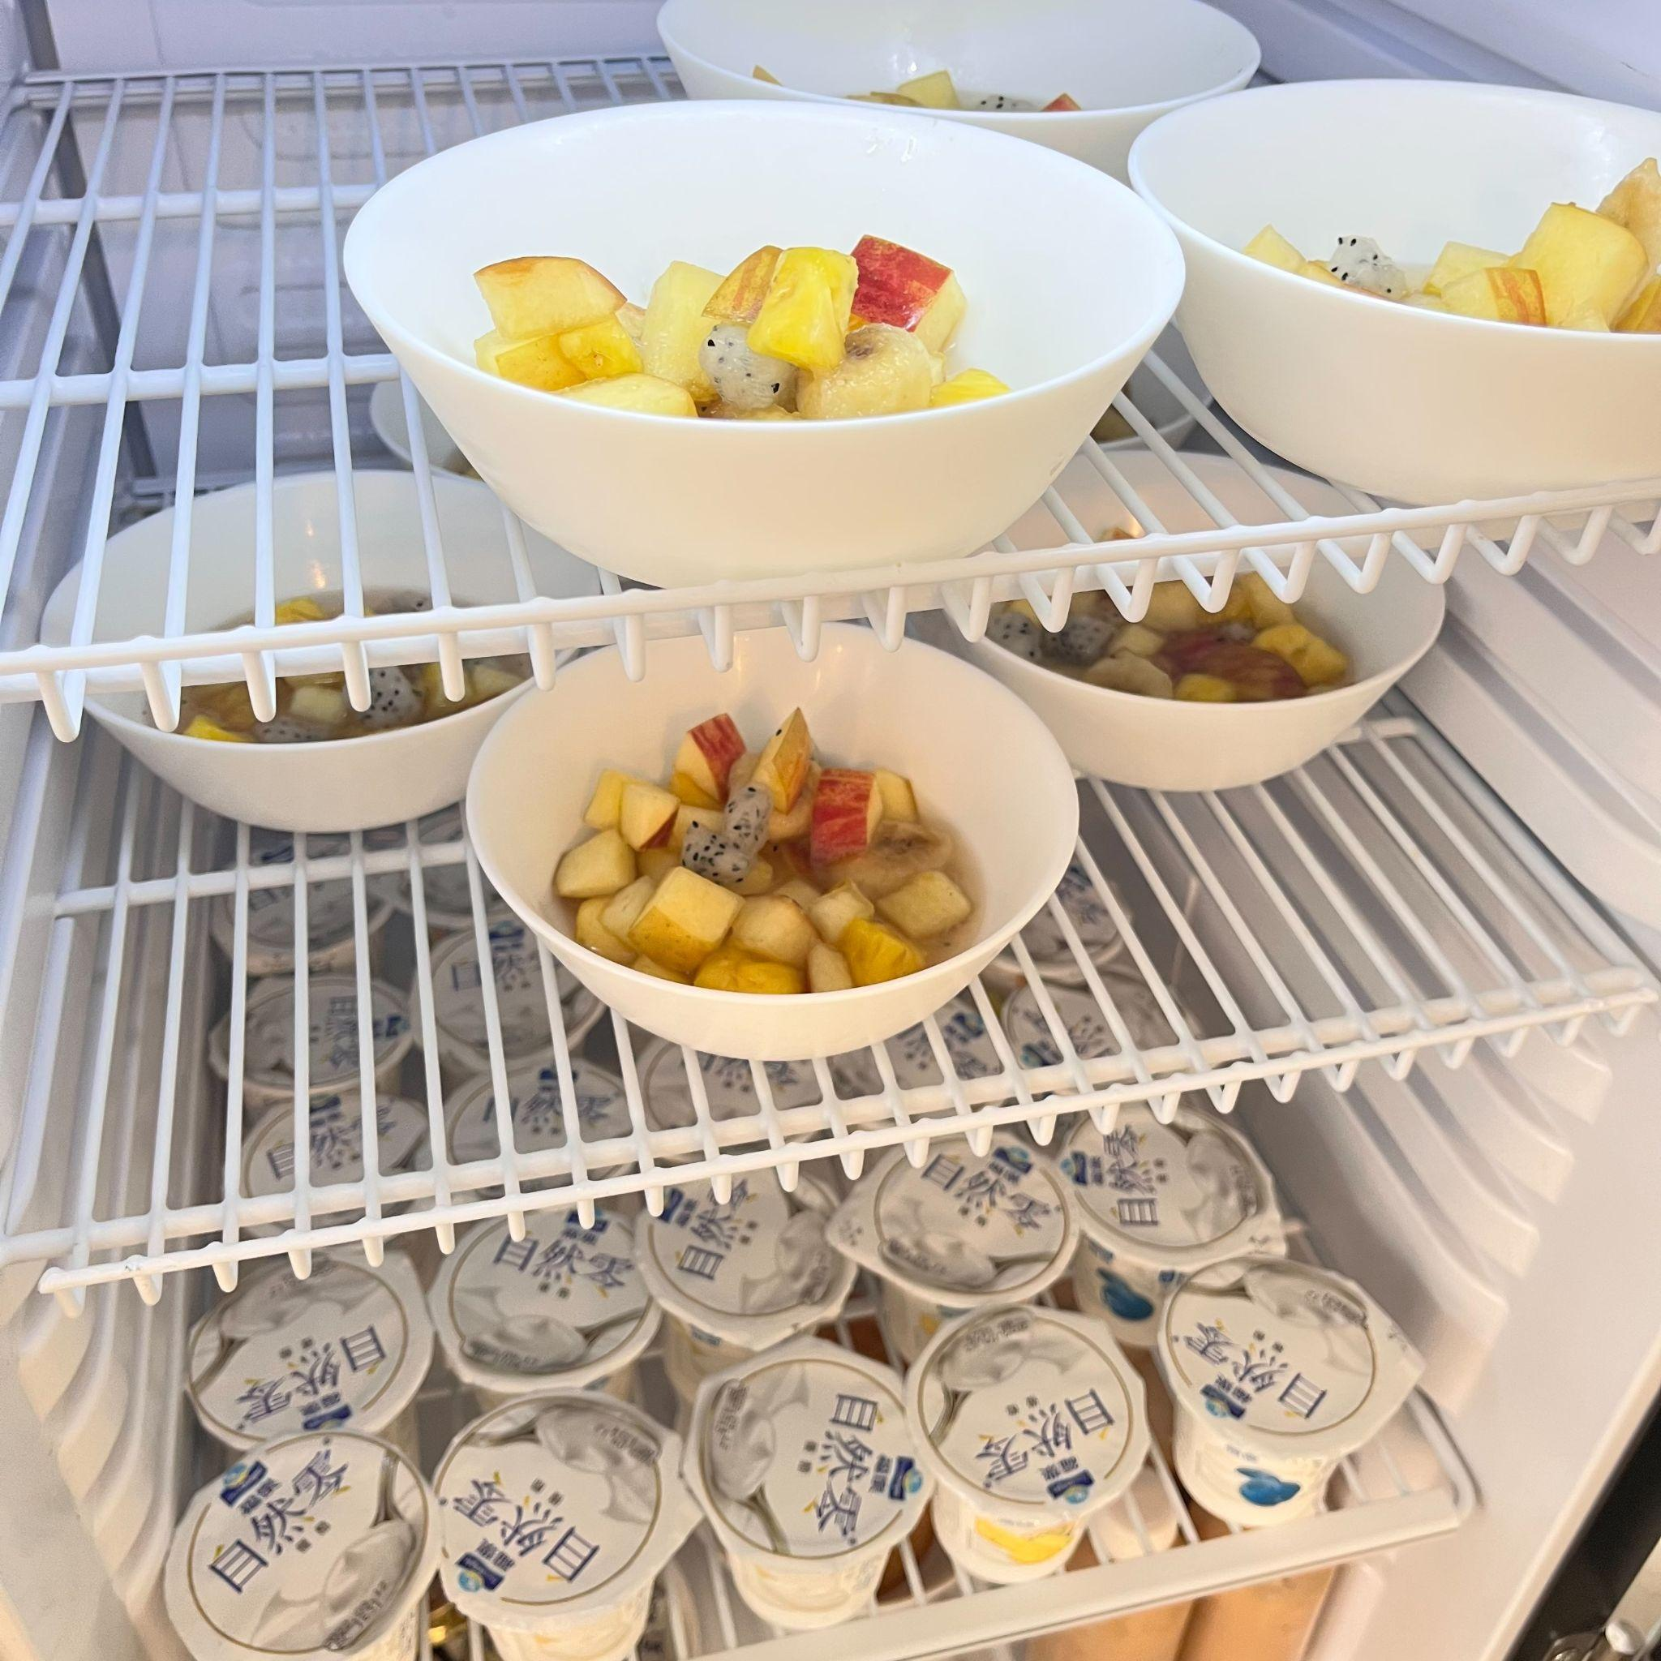
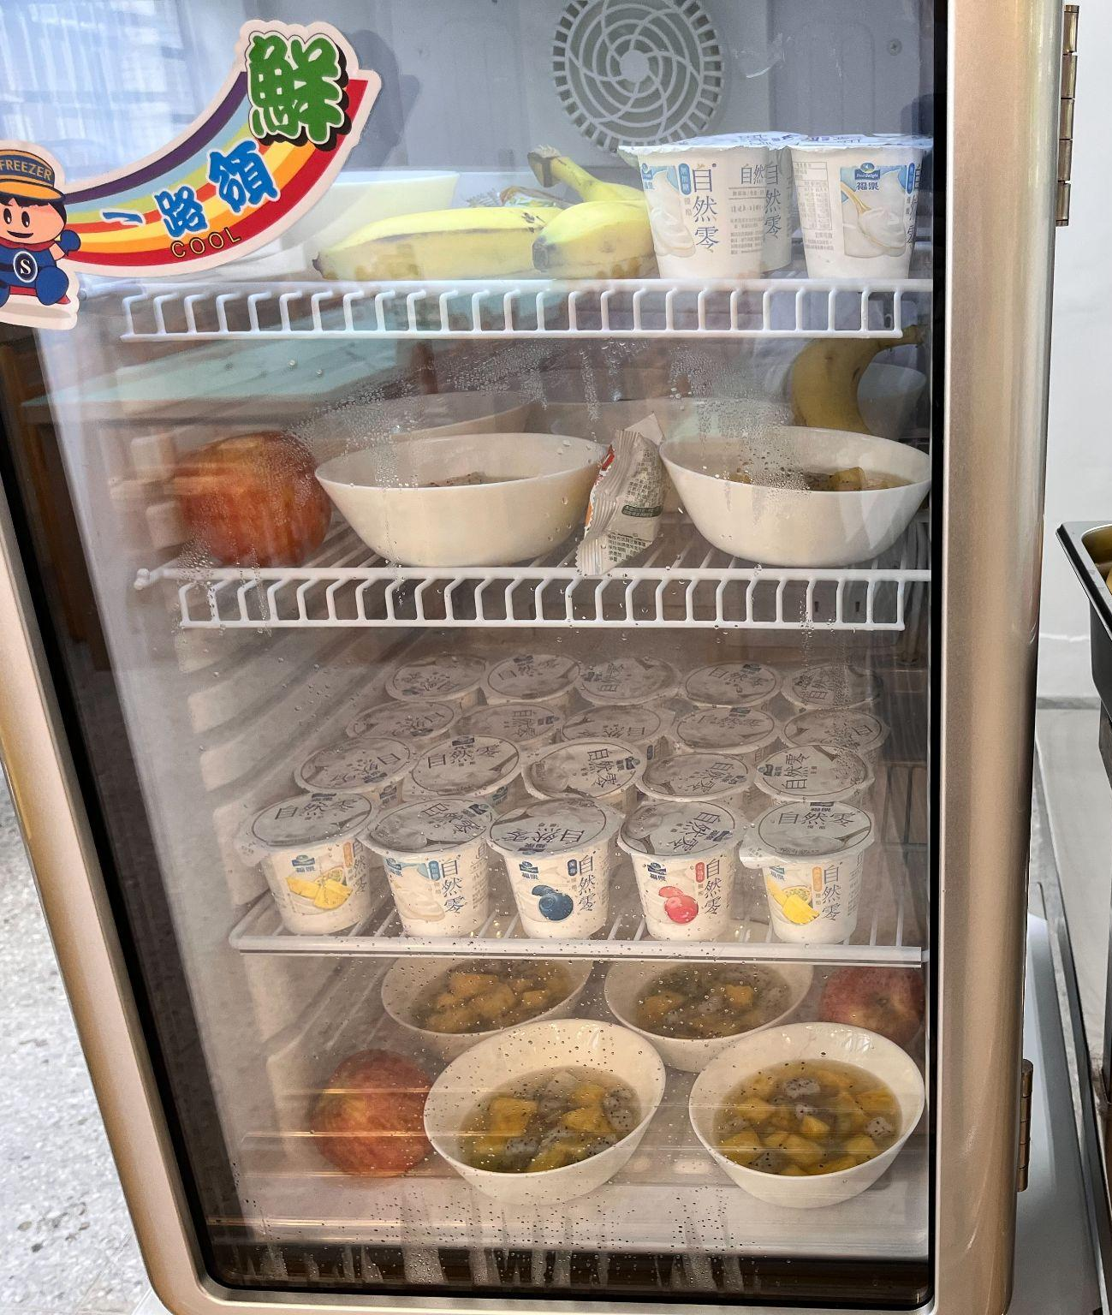

Slide 6
MENU EXAMPLE (MARCH 2023, week 03-13)
HOMEMADE, BEST INGREDIENTS
COOKED IN OUR KITCHEN
BY PROFESSIONAL CHEFS
 | 13 |  | Japanese Chicken Curry | Mix Green veggies | Pilaf rice | Yoghurt or Cheese | Salad of fruits
 | 14 |  | Fish lasagna (Salmon, Seabass, Basa) | Cauliflower gratin | N/A | Yoghurt or Cheese | Salad of fruits
 | 15 |  | Homemade dumplings | Roast vegetables | N/A | Yoghurt or Cheese | Salad of fruits
 | 16 |  | Pork sale aux lentilles | Green peas & Carrots | Lentils | Yoghurt or Cheese | Salad of fruits
 | 17 |  | Beef Meatballs , mushroom sauce | French ratatouille | Tagliatelles | Yoghurt or Cheese | Salad of fruits

Slide 7
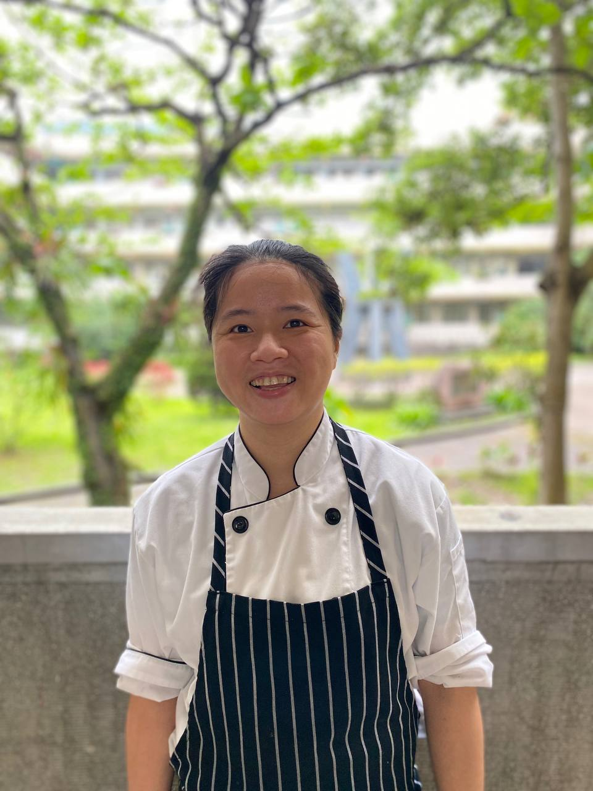
OUR TEAM
Michel Bru, head-chef & owner
Michel Bru is a French Chef with a strong reputation, and who has mostly worked in Michelin Star Restaurants and famous/wealthy customers. His experiences goes over 25 years and 4 countries (France, England, Scotland & Taiwan)
Yaling Lee, Canteen Manager
很榮幸能夠有機會為學校服務，我跟Michel 身邊一起工作將近五年，一路也跟Michel 學習很多。本身也很喜歡小孩跟喜歡做菜。之前學校有幾道台式餐點也是我給Michel 提供的建議及食譜：）

Slide 8
OUR CUSTOMERS
Since 2022, we are the proud catering school supplier of the pupils of :

Slide 9
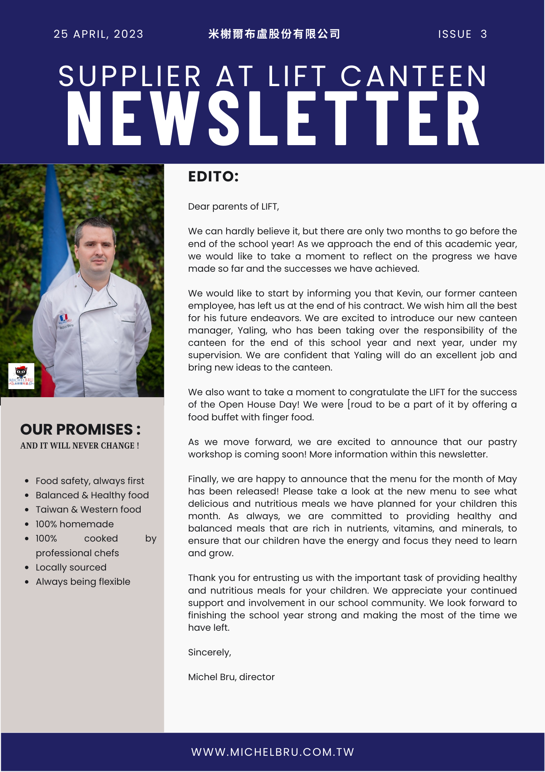
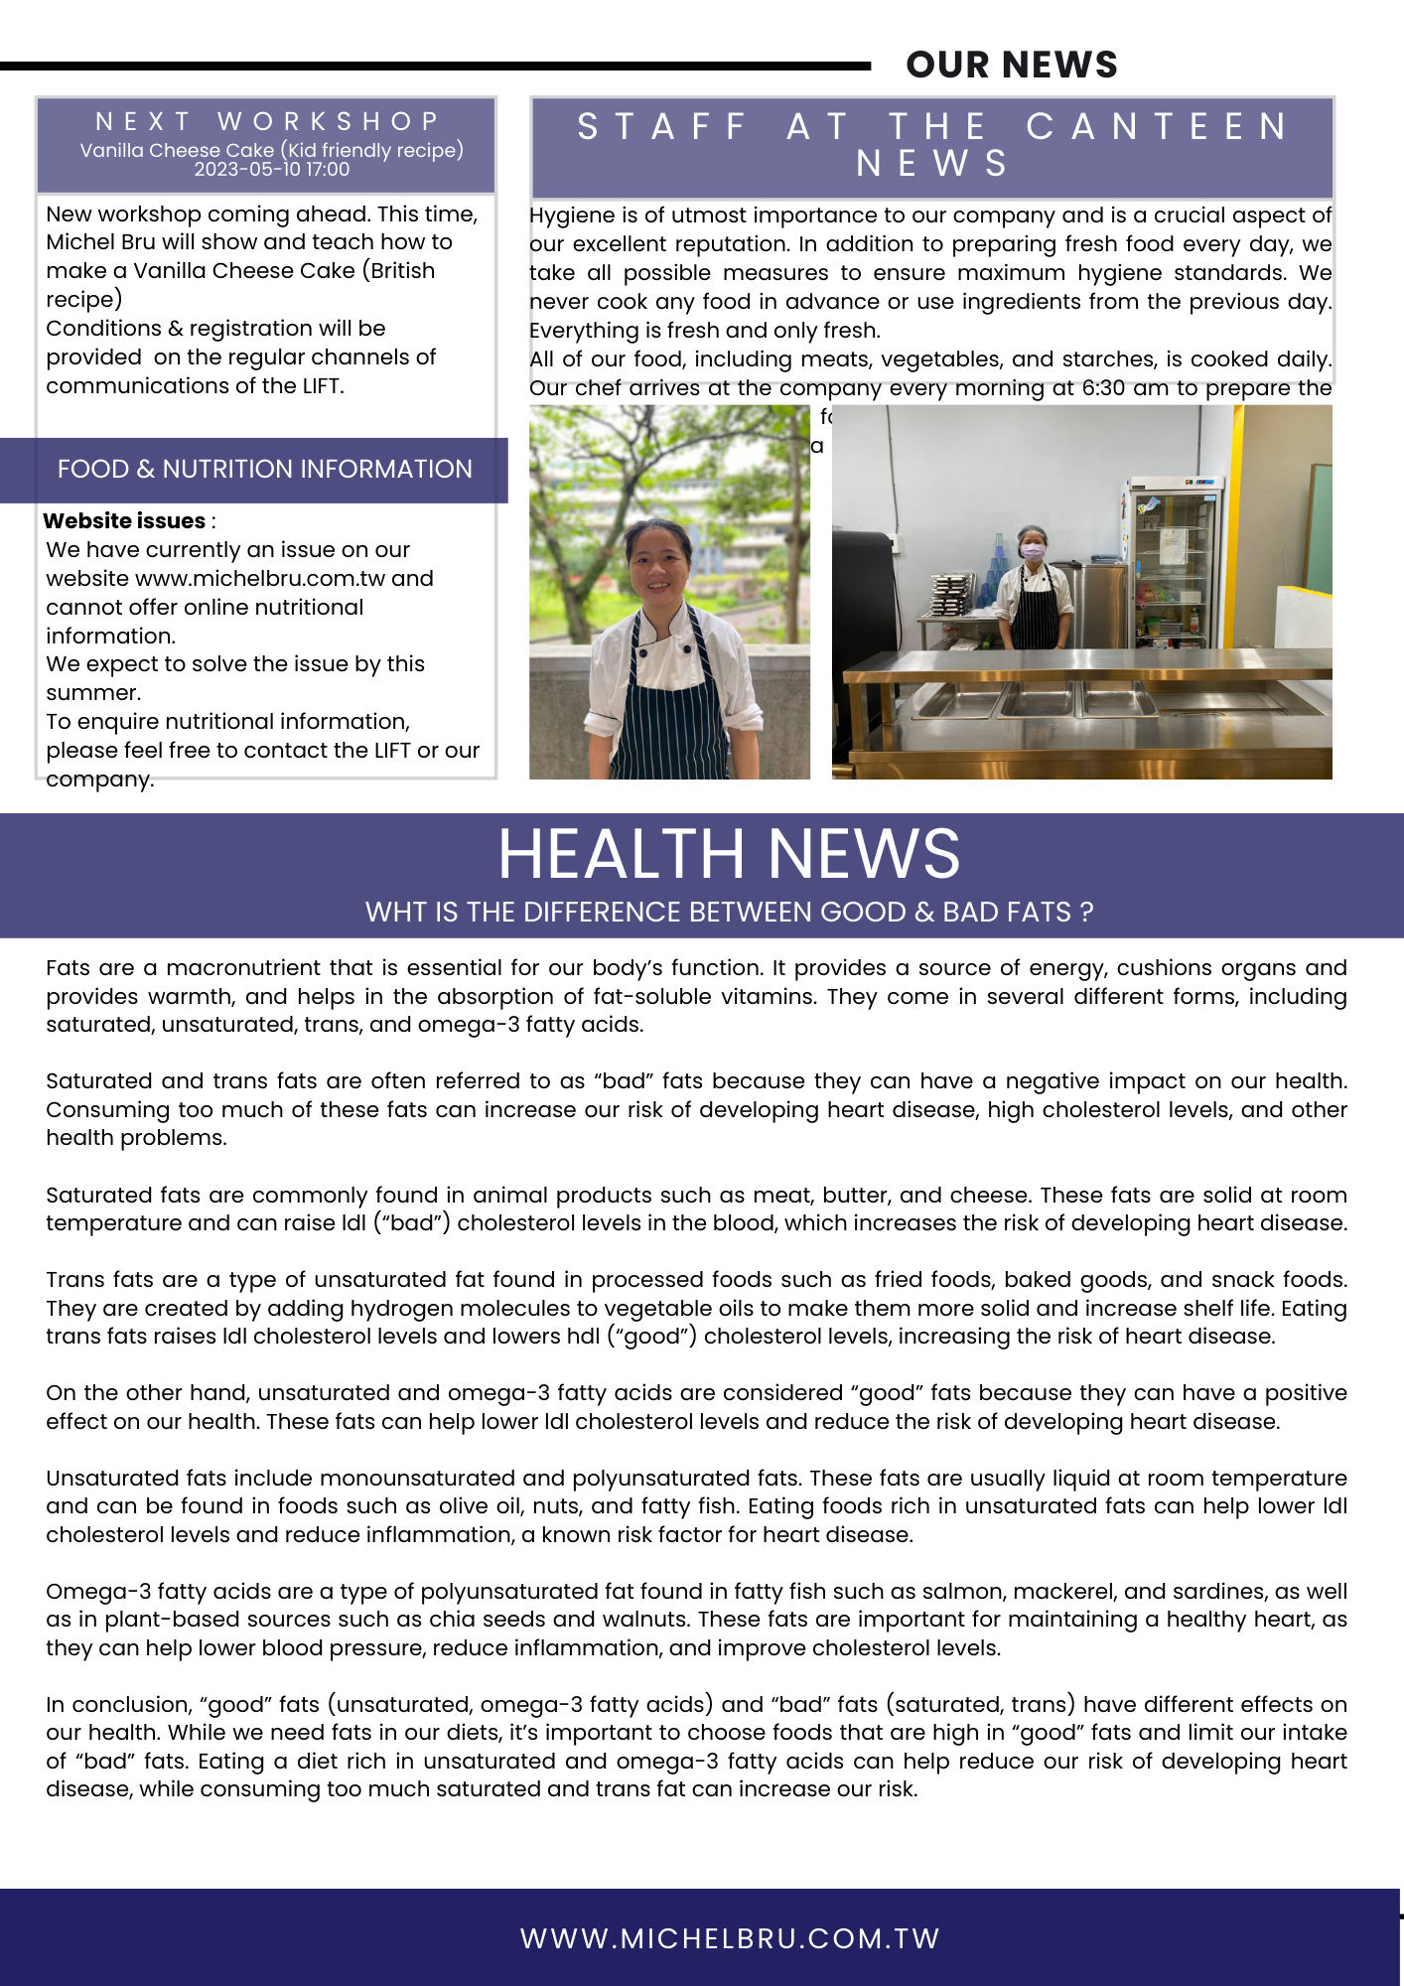
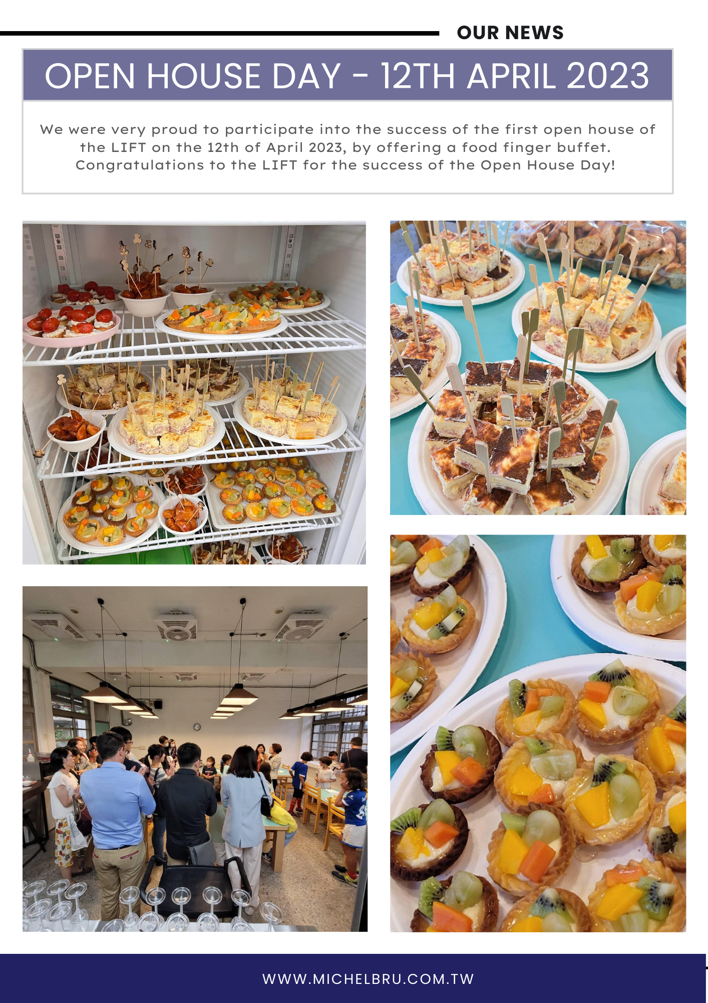

Slide 10
FOOD SAFETY & PROCESSES
Our successful certifications
Food safety & hygiene in the catering industry - 2023
Diploma in Human Nutritions (15h) - 2023
HACCP Food Safety System for restaurants & other catering service - 2023
Vegan Diet - Healthy Lifestyle (4h) - 2023
Our processes
Food traceability based on ISO 22005 requirements
SOP Emergency response plan
Food safety based on GHP & HACCP regulations

Slide 11
PRICING
Cleaning service cost + 13 NTD (Minimum 25 pupils)
10 - 24 pupils : 180 NTD
25 - 60 pupils : 160 NTD
61 - 100 pupils : 155 NTD
101 - 150 pupils : 140 NTD
151 - 200 pupils : 130 NTD
201+ : 120 NTD
Typical lunch
1 main-course + 1 dairy product + 1 dessert
Contract length
Minimum 1 year school
2 years contract (5 NTD discount)
Payment
By semester, 2 weeks before start.
Receipt & invoice is provided

Slide 12
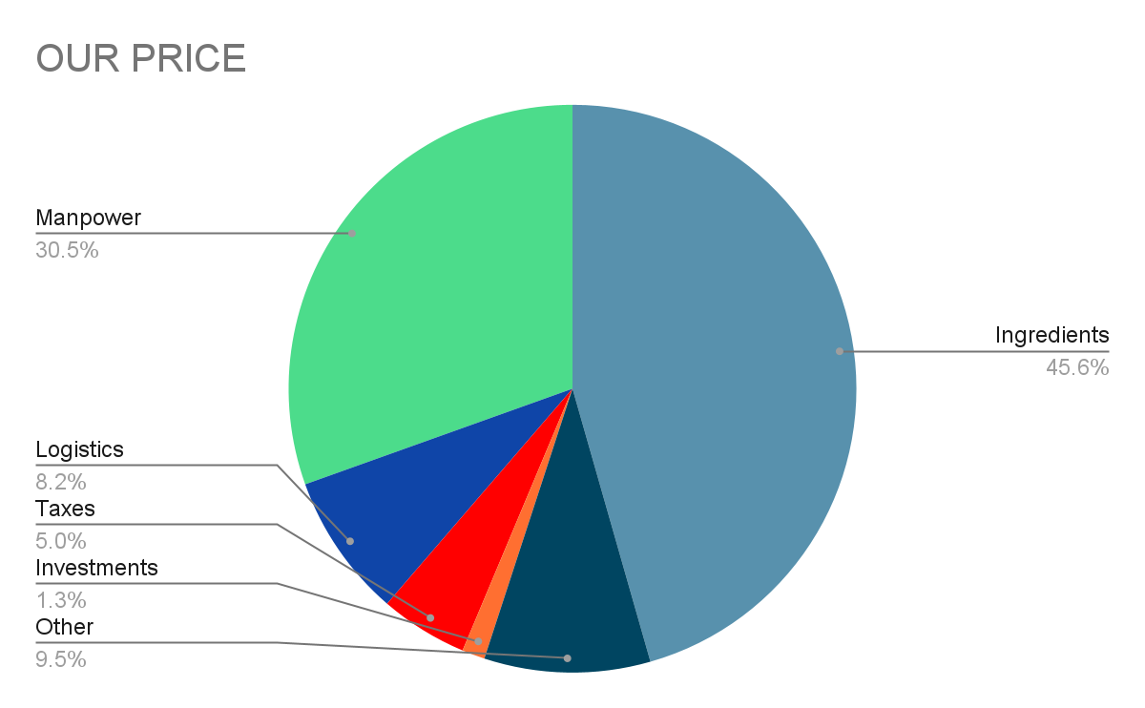
OUR PRICING POLICY TRANSPARENCY
Manpower Staff working at school + Chef cooking for school
Ingredients Ingredients we buy for the creation of our meals
Logistics All cost linked to transportation of our meals
Taxes Taxes to be paid
Investments Improvement/upgrade of tools for school purpose
Other Staff training, utilities bills, company margins etc

Slide 13
Download your PDF

